Slide 1
Lecture 8: concurrency
Prof Yotov
CS6233
Slides by Prof Sandoval
Some slides derived from : William Stallings, Tanenbaum/Bo, John Regehr and Brendan Dolan-Gavitt
Thanks !!

Slide 2
objectives

Slide 3
You will be able to
Understand the Challenges Concurrency poses in an Operating System
Understand the definitions of key terms like race condition, critical section, mutual exclusion, etc.
Understand Multiple Approaches to Enforcing Mutual Exclusion.
Understand classic problems like: Readers-Writers and Dining Philosophers.
Understand what is a Deadlock, Deadlock Protection and Avoidance.

Slide 4
This lecture
Concurrency
Mutual Exclusion
Hardware Support
Semaphores
Monitors
Readers/Writers Problem
Deadlocks
Detection & Recovery
Avoidance
Prevention

Slide 5
synchronization

Slide 6
What is Synchronization?
Question: How do you control the behavior of
"cooperating" processes that share resources?
Time | You | Your roomate
3:00 | Arrive home
3:05 | Check fridge →→ no milk
3:10 | Leave for grocery
3:15 |  | Arrive home
3:20 | Buy milk | Check fridge →→ no milk
3:25 | Arrive home, milk in fridge | Leave for grocery
3:30
3:35 |  | Buy milk
3:40 |  | Arrive home, milk in fridge!

Slide 7
Shared Memory Synchronization
Threads share memory
Preemptive thread scheduling is a major problem
Context switch can occur at any time, even in the middle of a line of code (e.g., "X = X + 1;")
» Unit of atomicity – Machine instruction
» Cannot assume anything about how fast processes make progress
Individual processes have little control over order in which processes run
Need to be paranoid about what scheduler might do
Preemptive scheduling introduces non-determinism

Slide 8
Issues in Concurrency
We want to run things concurrently for performance reasons
Particularly if we have multiple processors (even phones now typically have 2+ CPU cores)
Some of the Intel i7s have 6 cores. (i7-990x)
But when multiple concurrent tasks (processes or threads) need to operate on some shared resources, things can get messy

Slide 9
Race Condition
Two (or more) processes run in parallel and output depends on order in which they are executed
ATM Example
SALLY: balance += $50; BOB: balance -= $50;
Question: If initial balance is $500, what will final balance be?
SALLY
X = ReadBalance(500)
X = X + 50
WriteBalance(X)
BOB
This (or reverse) is what you'd normally expect to happen.
Y = ReadBalance(550)
Y = Y - 50
WriteBalance(Y)
Net: $500

Slide 10

Race Conditions
Two (or more) processes run in parallel and output depends on order in which they are executed
ATM Example
SALLY: balance += $50; BOB: balance -= $50;
Question: If initial balance is $500, what will final balance be?
SALLY
X = ReadBalance(500)
BOB
Y = ReadBalance(500)
However, this (or reverse) can happen due to a race condition.
X = X + 50
Y = Y - 50
WriteBalance(X)
WriteBalance(Y)
Net: $450

Slide 11
Race Conditions
If two processes or threads need to update some data at the same time, we may have a race condition
The name comes from the idea that the two are both racing each other to be the first to write or read the data
These correctness problems are notoriously difficult to debug – problem only occurs when the timing is just right and is hard to reproduce
Note that we don't actually need true parallelism here for a mistake to occur!
Just preemption at the wrong time
Multiple processors do make this sort of problem more likely to manifest, though

Slide 12
Time
Process 1
Process 2
Process 3
(a) Interleaving (multiprogramming, one processor)
Process 1
Process 2
Process 3
(b) Interleaving and overlapping (multiprocessing; two processors)
Blocked
Running
Source: Stallings
Notes:
If the work to be done by a computer can be organized so that
some portions of the work can be done in parallel, then a system with multiple
processors will yield greater performance than one with a single processor of
the same type. This is illustrated in Figure 2.12 . With multiprogramming, only
one process can execute at a time; meanwhile all other processes are waiting
for the processor. With multiprocessing, more than one process can be running
simultaneously, each on a different processor.

Slide 13

Synchronization
The race condition happened because there were conflicting accesses to a resource
Basic idea behind most synchronization:
If two threads, processes, interrupt handlers, etc. are going to have conflicting accesses, force one of them wait until it is safe to proceed
Conceptually simple, but difficult in practice
The problem is that we need to protect all possible locations where two (or more) threads or processes might conflict

Slide 14

Synchronization Problems
Synchronization can be required for different resources
Memory: e.g., multithreaded application
OS object: e.g., two processes that read/write same system file
Hardware device: e.g. two processes that both want to burn a DVD
There are different kinds of synchronization problems
Sometimes we just want activities to not interfere with each other
Sometimes we care about ordering

Slide 15
Synchronization Problems
Synchronization may be across machines
What if some machines are disconnected or rebooting?
Sometimes it’s not OK to block a thread or process
May have to reserve the "right" do something ahead of time

Slide 16

Atomic Operations
Series of operations that cannot be interrupted
Some operations are atomic with respect to everything that happens on a machine
Other atomic operations are atomic only with respect to conflicting processes, threads, interrupt handlers, etc.
On typical architectures:
Individual word load/stores and ALU instructions
Synchronization operations (e.g., fetch_and_add, cmp_and_swap)
ATM example →→ Balance updates were NOT atomic
Solution: Enforce atomic balance updates
Question: How?

Slide 17
More Atomic
Atomic operations are at the root of most synchronization solutions
Processor has to support some atomic operations
If not, we’re stuck!
OS uses low-level primitives to build up more sophisticated atomic operations
For example, locks that support blocking instead of busy-waiting
We’ll look at an example soon

Slide 18
More Definitions
Synchronization (or Concurrency Control):
Using atomic operations to eliminate race conditions
Critical section:
Piece of code (e.g., ATM balance update) that must run atomically
Mutual exclusion: Ensure at most one process at a time
Lock:
Synchronization mechanism that enforces atomicity
Semantics:
» Lock(L): If L is not currently locked →→ atomically lock it
If L is currently locked →→ block until it becomes free
» Unlock(L): Release control of L
– You can use a lock to protect data: Lock(L) before accessing data, Unlock(L) when done

Slide 19
Mutual exclusion

Slide 20
Mutual Exclusion
The key trouble we ran into was that the read-update-write sequence on a shared resource could be interleaved between two processes
(read1-read2-update2-write2-update1-write1)
The way to solve this is through mutual exclusion –making sure that only one process has access to the shared resource at a time

Slide 21
Critical Regions/Sections
We can formulate the problem by classifying what programs do into two parts
The majority of the time they do things that don't require synchronization; the things they do only affect non-shared resources
Some of the time, they need to access shared memory or files; we call this a critical region or critical section of the program
If we can arrange it so that two programs are never in a critical section at the same time, we can avoid race conditions

Slide 22
Requirements
No two processes may be simultaneously inside their critical regions
No assumptions may be made about speeds or the number of CPUs
No process running outside its critical region may block any process
No process should have to wait forever to enter its critical region

Slide 23
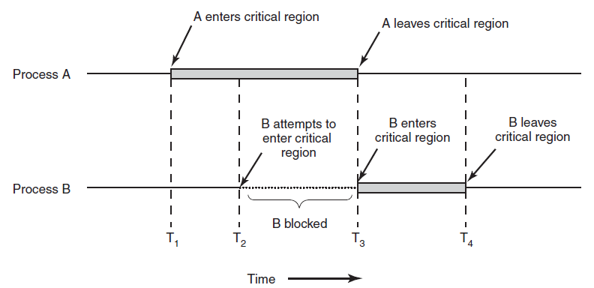
Critical Regions
Figure 2-22. Mutual exclusion using critical regions.

Slide 24
Lock Variable
void acquire(struct spinlock *lk) {
for(;;) {
if(!lk->locked) {
lk->locked = 1;
break;
}
}
}
To enter a critical region, wait until the lock variable is 0, then set it to 1
To leave the critical region, just set the lock back to 0
What's wrong with this idea?

Slide 25
Peterson's Algorithm
#define FALSE 0
#define TRUE 1
#define N 2 /* number of processes */
int turn; /* whose turn is it? */
int interested[N]; /* all values initially 0 (FALSE) */
void enter_region(int process); /* process is 0 or 1 */
{
int other; /* number of the other process */
other = 1 − process; /* the opposite of process */
interested[process] = TRUE; /* show that you are interested */
turn = process; /* set flag */
while (turn == process && interested[other] == TRUE) {
// Do nothing
}
}
void leave_region(int process) { /* process: who is leaving */
interested[process] = FALSE; /* indicate departure from critical region */
}
Notes:
Before using the shared variables, each process:
calls enter_region() with it’s own process number, 0 or 1 as parameter. This will cause it to wait until it’s safe to enter.
after it has finished with the shared variables it calls leave_region() to indicate that it is done and to allow the other process to enter.
Let’s see how this works:
Initially no process in the critical region
Process 0 calls enter_region()
It indicates interest by seeting the array element to 0 and also the turn to 0

Slide 26
Peterson's Algorithm
Each process indicates its interest by setting its entry in the "interested" array
Then, it sets the global turn variable to its own process number
Finally, loop until turn indicates that it's our turn and we see that the other process is no longer interested
There is still a race – but regardless of the winner, only one process will get to enter its critical region
Notes:
A concurrent programing algo for mutual exclusion that allows two or more processes so share a single-use resource without conflict. Formulated by Gary Peterson in 1981. While the original formulation was only for 2 processes it can be generalized to more than 2.

Slide 27
Hardware support: disable interrupts
Interrupt Disabling
uniprocessor system
disabling interrupts
guarantees mutual
exclusion
Disadvantages:
the efficiency of
execution could be
noticeably degraded
this approach will not
work in a
multiprocessor
architecture
Notes:
In a uniprocessor system, concurrent processes cannot have overlapped execution;
they can only be interleaved. Furthermore, a process will continue to run until it
invokes an OS service or until it is interrupted. Therefore, to guarantee mutual exclusion,
it is sufficient to prevent a process from being interrupted. This capability
can be provided in the form of primitives defined by the OS kernel for disabling and
enabling interrupts.
Because the critical section cannot be interrupted, mutual exclusion is guaranteed.
The price of this approach, however, is high. The efficiency of execution could
be noticeably degraded because the processor is limited in its ability to interleave
processes. Another problem is that this approach will not work in a multiprocessor
architecture. When the computer includes more than one processor, it is possible (and
typical) for more than one process to be executing at a time. In this case, disabled
interrupts do not guarantee mutual exclusion.

Slide 28
Hardware Support: atomic instruction
We can have a simpler solution if the hardware helps us out a bit with an atomic instruction
For example, "test and set lock": TSL RX, LOCK
Atomically reads the memory at address LOCK into RX and then stores a nonzero value back into LOCK
No other processor is allowed to access the memory at address LOCK until TSL is done
CPU instructions

Slide 29
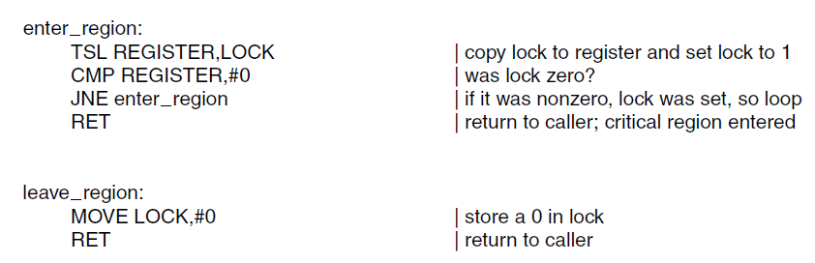
the TSL Instruction
Entering and leaving a critical region using the TSL instruction.

Slide 30
Hardware support: Atomic Locking
Compare & Swap Instruction
also called a “compare and exchange instruction”
a compare is made between a memory value and a test value
if the values are the same a swap occurs
carried out atomically
Notes:
This version of the instruction checks a memory location ( *word ) against a test value ( testval ). If the memory location’s current value is testval, it is replaced with newval ; otherwise it is left unchanged. The old memory value is always returned; thus, the memory location has been updated if the returned value is the same as the test value. This atomic instruction therefore has two parts: A compare is made between a memory value and a test value; if the values are the same, a swap occurs. The entire compare&swap function is carried out atomically—that is, it is not subject to interruption.
Another version of this instruction returns a Boolean value: true if the swap occurred; false otherwise. Some version of this instruction is available on nearly all processor families (x86, IA64, sparc, IBM z series, etc.), and most operating systems use this instruction for support of concurrency.

Slide 31
Hardware support: Atomic Locking
A similar instruction exists on x86: xchg REG, MEM
Atomically exchanges the contents of a register and a memory location
You can see that this is equivalent to TSL if the register is set to 1

Slide 32
xv6 Lock using XCHG
void
acquire(struct spinlock *lk)
{
pushcli(); // disable interrupts to avoid deadlock.
if(holding(lk))
panic("acquire");
// The xchg is atomic.
// It also serializes, so that reads after acquire are not
// reordered before it.
while(xchg(&lk->locked, 1) != 0)
;
// Record info about lock acquisition for debugging.
lk->cpu = cpu;
getcallerpcs(&lk, lk->pcs);
}
Notes:
The return value is the original value.

Slide 33
Busy Waiting
Whenever the a process is waiting to enter a critical section under these schemes, it sits in an infinite loop
This wastes CPU time
It can also interact badly with scheduling
Both Petterson’s Algo and Hardware approaches suffer from Busy Waiting.

Slide 34
Priority Inversion
Suppose we're using priority scheduling, and we have a high-priority process H and a low priority process L
So whenever H is runnable, it will always be chosen over L
Now, L enters a critical region, but is then preempted to run H
H wants to enter the critical region, but the lock is already held by L, so it enters a busy wait loop
But now H is always runnable, and will always be chosen over L, so L can never leave its critical region and the system is stuck

Slide 35

The Martian Inversion
The Mars Pathfinder mission used the VxWorks realtime operating system with priority scheduling
Meterological data gathering was low-priority task, communication task was medium-priority
Both shared a data bus, controlled by a lock
This caused a classic priority inversion, hanging the lander until the watchdog timer reset it

Slide 36

The Martian Inversion
This was debugged from 140 million miles away by examining system log data
Fixed by uploading a snippet of C code that turned on priority inheritance for the lock
Priority inheritance says that a process holding a lock is elevated to the highest priority of anything waiting for the lock
Notes:
If you hold a lock, you get promoted so that you can make progress.

Slide 37
Sleep and Wakeup
Instead of waiting in a loop, wasting CPU, we would like to put the waiting process to sleep, waking up when the lock is released
Often, sleep and wakeup take as parameters the address of some variable so we can match up sleeps with wakeups
E.g., in xv6:
sleep(void *chan)
wakeup(void *chan)

Slide 38
Producer-Consumer
Imagine we have two tasks, one that produces items and places them in a fixed-size buffer, and one that consumes them
An example you have seen already – a pipe!
If the buffer is full, the producer sleeps until there's space
If the buffer is empty, the consumer sleeps until there's data available

Slide 39
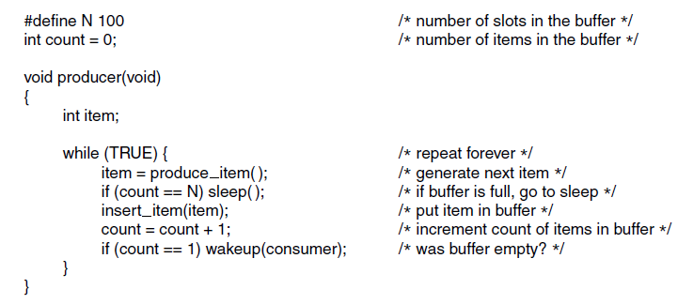
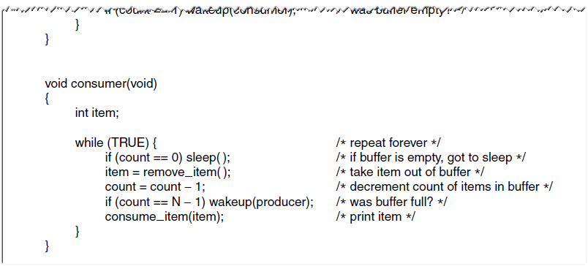
The Producer-Consumer Problem
Notes:
Assume:
Buffer is empty. Consumer just read count to see if it’s 0
At that point the scheduler decides to stop running the consumer temporarily and start running the producer.
Producer insters an intem into the buffer, increments count and notices that it’s now1
Since it is now 1, it wakes up the consumer
Unfortunately the consumer is not yet asleep (just preempted), so the signal is lost.
When the consumer next wakes up, it sees that the count it read is zero, so it goes to sleep
Sooner or later the producer will fill up the buffer and go to sleep
Both will sleep forever.
Could you fix it?
Wakeup bit…

Slide 40
The Lost Wakeup Problem
Suppose the buffer is empty, and consumer checks that count is 0
Just before consumer actually goes to sleep, it gets preempted, and producer puts something in the buffer
Since count is now 1, producer tries to wake up consumer, but consumer isn't asleep yet, so it does nothing
Control returns to the consumer, who goes to sleep, and never wakes up – it has missed its wakeup

Slide 41
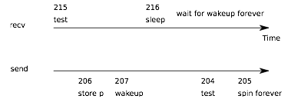
Lost Wakeup

Slide 42
Solving the Lost Wakeup Problem
We can have the producer and the consumer share a lock
The consumer acquires the lock, checks the value of count, and goes to sleep, passing the lock to the sleep function, which releases it
The producer acquires the lock before calling wakeup; if the process is not yet fully asleep, it will wait, ensuring that the wakeup is sent after the process is actually asleep
Notes:
The consumer is gonna sleep while holding the lock
Two operations that need to be atomic: Check count & goto sleep
The xv6 pipe implementation. It’s doing just this.

Slide 43
Mutexes
A mutex is a way to have mutual exclusion without busy waiting
Implementation is very similar to the busy-wait version of critical regions, but instead of looping, we yield the CPU

Slide 44
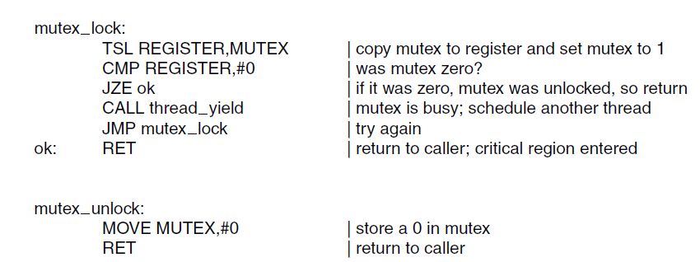
Mutex Code

Slide 45
Locks and Interrupts
Is something wrong with this code? If so, how could you fix it?
char temp;
void interrupt_handler(void) {
char x1, x2;
x1 = inb(0x120); // read from I/O port
x2 = inb(0x121); // read from I/O port
acknowledge_interrupt();
temp = x1;
x1 = x2;
x2 = temp;
printf("Got and swapped x1=%d x2=%d\n", x1, x2);
}

Slide 46
Locks and Interrupts
It's tempting to just add a lock around the swap:
char temp;
void interrupt_handler(void) {
char x1, x2;
x1 = inb(0x120); // read from I/O port
x2 = inb(0x121); // read from I/O port
acknowledge_interrupt();
acquire(&lock);
temp = x1;
x1 = x2;
x2 = temp;
release(&lock);
printf("Got and swapped x1=%d x2=%d\n", x1, x2);
}

Slide 47
Locks and Interrupts
But now consider what happens if we get an interrupt that calls interrupt_handler after we acquire the lock
We re-enter interrupt_handler, which tries to acquire the lock...
But it can't! The lock is held by the earlier call to the interrupt handler, which

Slide 48
Avoiding Interrupt Deadlocks
To get around this problem, we must make sure that when a lock is held by an interrupt handler we disable interrupts
xv6 actually goes further – all locks in the kernel disable interrupts on acquire and re-enable on release
Notes:
To make things safe.
Disable on acquire and reenable on release

Slide 49

Common
Concurrency
Mechanisms
Notes:
We now turn to OS and programming language mechanisms that are used to provide concurrency. Table 5.3 summarizes mechanisms in common use. We begin, in this section, with semaphores. The next two sections discuss monitors and message passing. The other mechanisms in Table 5.3 are discussed when treating specific operating system examples, in Chapters 6 and 13 .

Slide 50

Semaphores
One way to solve the lost wakeup problem is by using a lock
Another way to solve this problem is to use a semaphore: an integer to count the number of wakeups pending
Photo Credit: AmosWolfe

Slide 51
Semaphore
A variable that has an integer value upon which only three operations are defined:
There is no way to inspect or manipulate semaphores other than these three operations
May be initialized to a nonnegative integer value
The semWait operation decrements the value
The semSignal operation increments the value
Notes:
The fundamental principle is this: Two or more processes can cooperate by means of simple signals, such that a process can be forced to stop at a specified place until it has received a specific signal. Any complex coordination requirement can be satisfied by the appropriate structure of signals. For signaling, special variables called semaphores are used. To transmit a signal via semaphore s , a process executes the primitive semSignal(s) . To receive a signal via semaphore s , a process executes the primitive semWait(s) ; if the corresponding signal has not yet been transmitted, the process is suspended until the transmission takes place.
To achieve the desired effect, we can view the semaphore as a variable that has an integer value upon which only three operations are defined:
1. A semaphore may be initialized to a nonnegative integer value.
2. The semWait operation decrements the semaphore value. If the value becomes negative, then the process executing the semWait is blocked.
Otherwise, the process continues execution.
3. The semSignal operation increments the semaphore value. If the resulting value is less than or equal to zero, then a process blocked by a semWait operation, if any, is unblocked. Other than these three operations, there is no way to inspect or manipulate semaphores.
We explain these operations as follows. To begin, the semaphore has a zero or positive value. If the value is positive, that value equals the number of processes that can issue a wait and immediately continue to execute. If the value is zero, either by initialization or because a number of processes equal to the initial semaphore value have issued a wait, the next process to issue a wait is blocked, and the semaphore value goes negative. Each subsequent wait drives the semaphore value further into minus territory. The negative value equals the number of processes waiting to be unblocked. Each signal unblocks one of the waiting processes when the semaphore value is negative.

Slide 52
Consequences
There is no way to know before a process decrements a semaphore whether it will block or not
There is no way to know which process will continue immediately on a uniprocessor system when two processes are running concurrently
You don’t know whether another process is waiting so the number of unblocked processes may be zero or one
Notes:
[DOWN08] points out three interesting consequences of the semaphore definition:
• In general, there is no way to know before a process decrements a semaphore whether it will block or not.
After a process increments a semaphore and another process gets woken up, both processes continue running concurrently. There is no way to know which process, if either, will continue immediately on a uniprocessor system.
• When you signal a semaphore, you don’t necessarily know whether another process is waiting, so the number of unblocked processes may be zero or one.

Slide 53
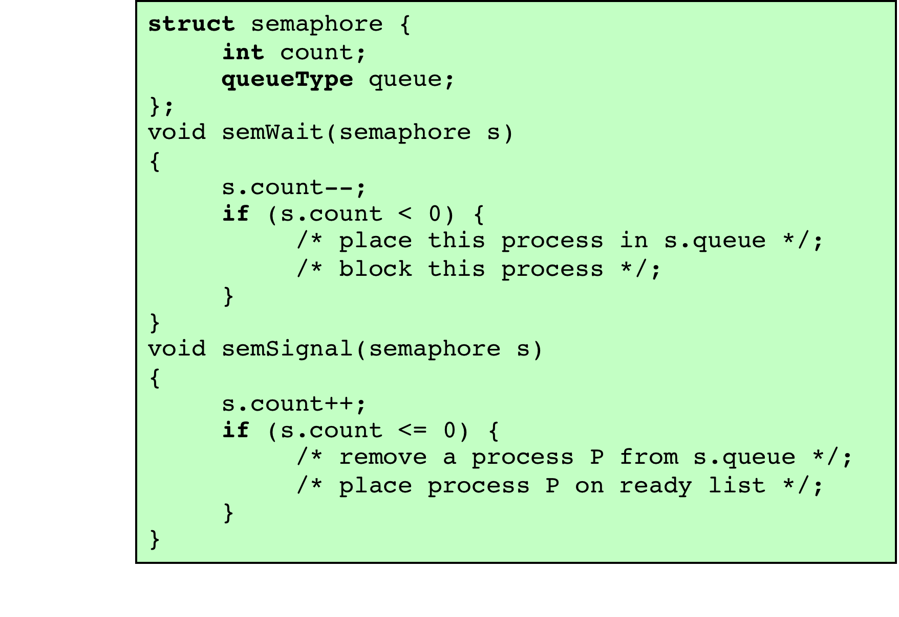
A
Definition
of Semaphore Primitives
Both semWait and semSignal are assumed to be atomic.
Notes:
Figure 5.3 suggests a more formal definition of the primitives for semaphores. The semWait and semSignal primitives are assumed to be atomic.

Slide 54
Definition of Binary Semaphore Primitives
Notes:
A more restricted version, known as the binary semaphore , is defined in Figure 5.4 . A binary semaphore may only take on the values 0 and 1 and can be defined by the following three operations:
1. A binary semaphore may be initialized to 0 or 1.
2. The semWaitB operation checks the semaphore value. If the value is zero, then the process executing the semWaitB is blocked. If the value is one, then the value is changed to zero and the process continues execution.
3. The semSignalB operation checks to see if any processes are blocked on this semaphore (semaphore value equals 0). If so, then a process blocked by a semWaitB operation is unblocked. If no processes are blocked, then the value of the semaphore is set to one.
In principle, it should be easier to implement the binary semaphore, and it can be shown that it has the same expressive power as the general semaphore (see Problem 5.16). To contrast the two types of semaphores, the nonbinary semaphore is often referred to as either a counting semaphore or a general semaphore .
A concept related to the binary semaphore is the mutual exclusion lock
(mutex) . A mutex is a programming flag used to grab and release an object. When
data are acquired that cannot be shared or processing is started that cannot be
performed simultaneously elsewhere in the system, the mutex is set to lock (typically
zero), which blocks other attempts to use it. The mutex is set to unlock
when the data are no longer needed or the routine is finished. A key difference
between the a mutex and a binary semaphore is that the process that locks the
mutex (sets the value to zero) must be the one to unlock it (sets the value to 1). In
contrast, it is possible for one process to lock a binary semaphore and for another
to unlock it.

Slide 55
Strong/Weak Semaphores
A queue is used to hold processes waiting on the semaphore
Strong Semaphores
the process that has been blocked the longest is released from the queue first (FIFO)
Weak Semaphores
the order in which processes are removed from the queue is not specified
Notes:
For both counting semaphores and binary semaphores, a queue is used to hold processes waiting on the semaphore. The question arises of the order in which processes are removed from such a queue. The fairest removal policy is first-in-first-out (FIFO): The process that has been blocked the longest is released from the queue first; a semaphore whose definition includes this policy is called a strong semaphore . A semaphore that does not specify the order in which processes are removed from the queue is a weak semaphore .

Slide 56
Semaphore Example
Notes:
Figure 5.5 is an example of the operation of a strong semaphore. Here processes A, B, and C depend on a result from process D. Initially (1), A is running;
B, C, and D are ready; and the semaphore count is 1, indicating that one of D’s results is available. When A issues a semWait instruction on semaphore s , the semaphore decrements to 0, and A can continue to execute; subsequently it rejoins the ready queue. Then B runs (2), eventually issues a semWait instruction, and is blocked, allowing D to run (3). When D completes a new result, it issues a semSignal instruction, which allows B to move to the ready queue (4). D rejoins the ready queue and C begins to run (5) but is blocked when it issues a semWait instruction. Similarly, A and B run and are blocked on the semaphore, allowing D to resume execution (6). When D has a result, it issues a semSignal , which transfers C to the ready queue. Later cycles of D will release A and B from the Blocked state.

Slide 57
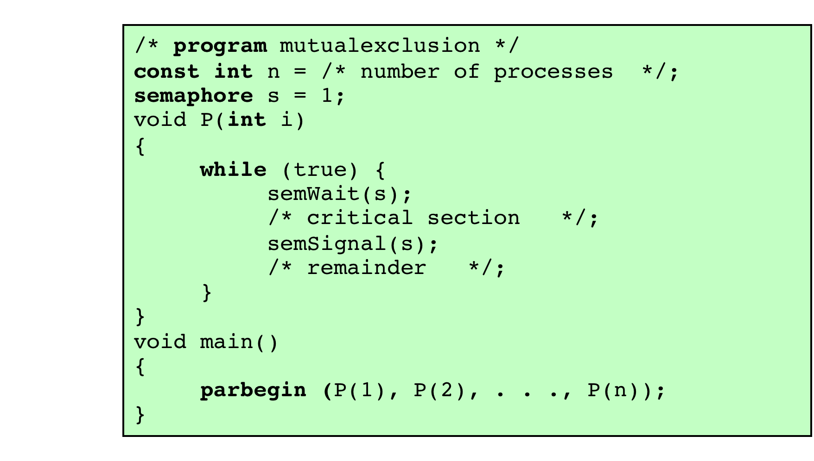
Mutual Exclusion Using Semaphores
Notes:
For the mutual exclusion algorithm discussed in the next subsection and illustrated in Figure 5.6 , strong semaphores guarantee freedom from starvation, while weak semaphores do not. We will assume strong semaphores because they are more convenient and because this is the form of semaphore typically provided by operating systems.
Figure 5.6 shows a straightforward solution to the mutual exclusion problem using a semaphore s (compare Figure 5.1 ). Consider n processes, identified in the array P ( i ), all of which need access to the same resource. Each process has a critical section used to access the resource. In each process, a semWait(s) is executed just before its critical section. If the value of s becomes negative, the process is blocked. If the value is 1, then it is decremented to 0 and the process immediately enters its critical section; because s is no longer positive, no other process will be able to enter its critical section.
The semaphore is initialized to 1. Thus, the first process that executes a semWait will be able to enter the critical section immediately, setting the value of s to 0. Any other process attempting to enter the critical section will find it busy and will be blocked, setting the value of s to –1. Any number of processes may attempt entry; each such unsuccessful attempt results in a further decrement of the value of s . When the process that initially entered its critical section departs, s is incremented and one of the blocked processes (if any) is removed from the queue of blocked processes associated with the semaphore and put in a Ready state. When it is next scheduled by the OS, it may enter the critical section.

Slide 58
Accessing shared data protected by a semaphore
Notes:
Figure 5.7, based on one in [BACO03], shows a possible sequence for three
processes using the mutual exclusion discipline of Figure 5.6. In this example three
processes (A, B, C) access a shared resource protected by the semaphore lock .
Process A executes semWait (lock) ; because the semaphore has a value of 1 at
the time of the semWait operation, A can immediately enter its critical section and
the semaphore takes on the value 0. While A is in its critical section, both B and
C perform a semWait operation and are blocked pending the availability of the
semaphore. When A exits its critical section and performs semSignal (lock) , B,
which was the first process in the queue, can now enter its critical section.

Slide 59

Monitors
Programming language construct that provides equivalent functionality to that of semaphores and is easier to control
Implemented in a number of programming languages
Java, C#, Concurrent Pascal, Pascal-Plus, and Modula
Has also been implemented as a program library
Software module consisting of one or more procedures, an initialization sequence, and local data
Notes:
The monitor is a programming-language construct that provides equivalent functionality to that of semaphores and that is easier to control. The concept was first formally defined in [HOAR74]. The monitor construct has been implemented in a number of programming languages, including Concurrent Pascal, Pascal-Plus, Modula-2, Modula-3, and Java. It has also been implemented as a program library. This allows programmers to put a monitor lock on any object. In particular, for something like a linked list, you may want to lock all linked lists with one lock, or have one lock for each list, or have one lock for each element of each list.
A monitor is a software module consisting of one or more procedures, an initialization sequence, and local data.

Slide 60
Monitor Characteristics
Local data variables are accessible only by the monitor’s procedures and not by any external procedure
Process enters monitor by invoking one of its procedures
Only one process may be executing in the monitor at a time
Notes:
The chief characteristics of a monitor are the following:
1. The local data variables are accessible only by the monitor’s procedures and
not by any external procedure.
2. A process enters the monitor by invoking one of its procedures.
3. Only one process may be executing in the monitor at a time; any other processes
that have invoked the monitor are blocked, waiting for the monitor to become available.
The first two characteristics are reminiscent of those for objects in object-oriented software. Indeed, an object-oriented OS or programming language can readily implement a monitor as an object with special characteristics.
By enforcing the discipline of one process at a time, the monitor is able to provide a mutual exclusion facility. The data variables in the monitor can be accessed by only one process at a time. Thus, a shared data structure can be protected by placing it in a monitor. If the data in a monitor represent some resource, then the monitor provides a mutual exclusion facility for accessing the resource.
To be useful for concurrent processing, the monitor must include synchronization tools. For example, suppose a process invokes the monitor and, while in the
monitor, must be blocked until some condition is satisfied. A facility is needed by which the process is not only blocked but releases the monitor so that some other process may enter it. Later, when the condition is satisfied and the monitor is again available, the process needs to be resumed and allowed to reenter the monitor at the point of its suspension.

Slide 61
Synchronization
Achieved by the use of condition variables that are contained within the monitor and accessible only within the monitor
Condition variables are operated on by two functions:
cwait(c): suspend execution of the calling process on condition c
csignal(c): resume execution of some process blocked after a cwait on the same condition
Notes:
A monitor supports synchronization by the use of condition variables that are contained within the monitor and accessible only within the monitor. Condition variables are a special data type in monitors, which are operated on by two functions:
• cwait(c) : Suspend execution of the calling process on condition c . The monitor is now available for use by another process.
• csignal(c) : Resume execution of some process blocked after a cwait on the same condition. If there are several such processes, choose one of them; if there is no such process, do nothing.
Note that monitor wait and signal operations are different from those for the semaphore. If a process in a monitor signals and no task is waiting on the condition variable, the signal is lost.

Slide 62
Notes:
Figure 5.15 illustrates the structure of a monitor. Although a process can enter the monitor by invoking any of its procedures, we can think of the monitor as having a single entry point that is guarded so that only one process may be in the monitor at a time. Other processes that attempt to enter the monitor join a queue of processes blocked waiting for monitor availability. Once a process is in the monitor, it may temporarily block itself on condition x by issuing cwait(x) ; it is then placed in a queue of processes waiting to reenter the monitor when the condition changes, and resume execution at the point in its program following the cwait(x) call. If a process that is executing in the monitor detects a change in the condition variable x , it issues csignal(x) , which alerts the corresponding condition queue that the condition has changed.

Slide 63
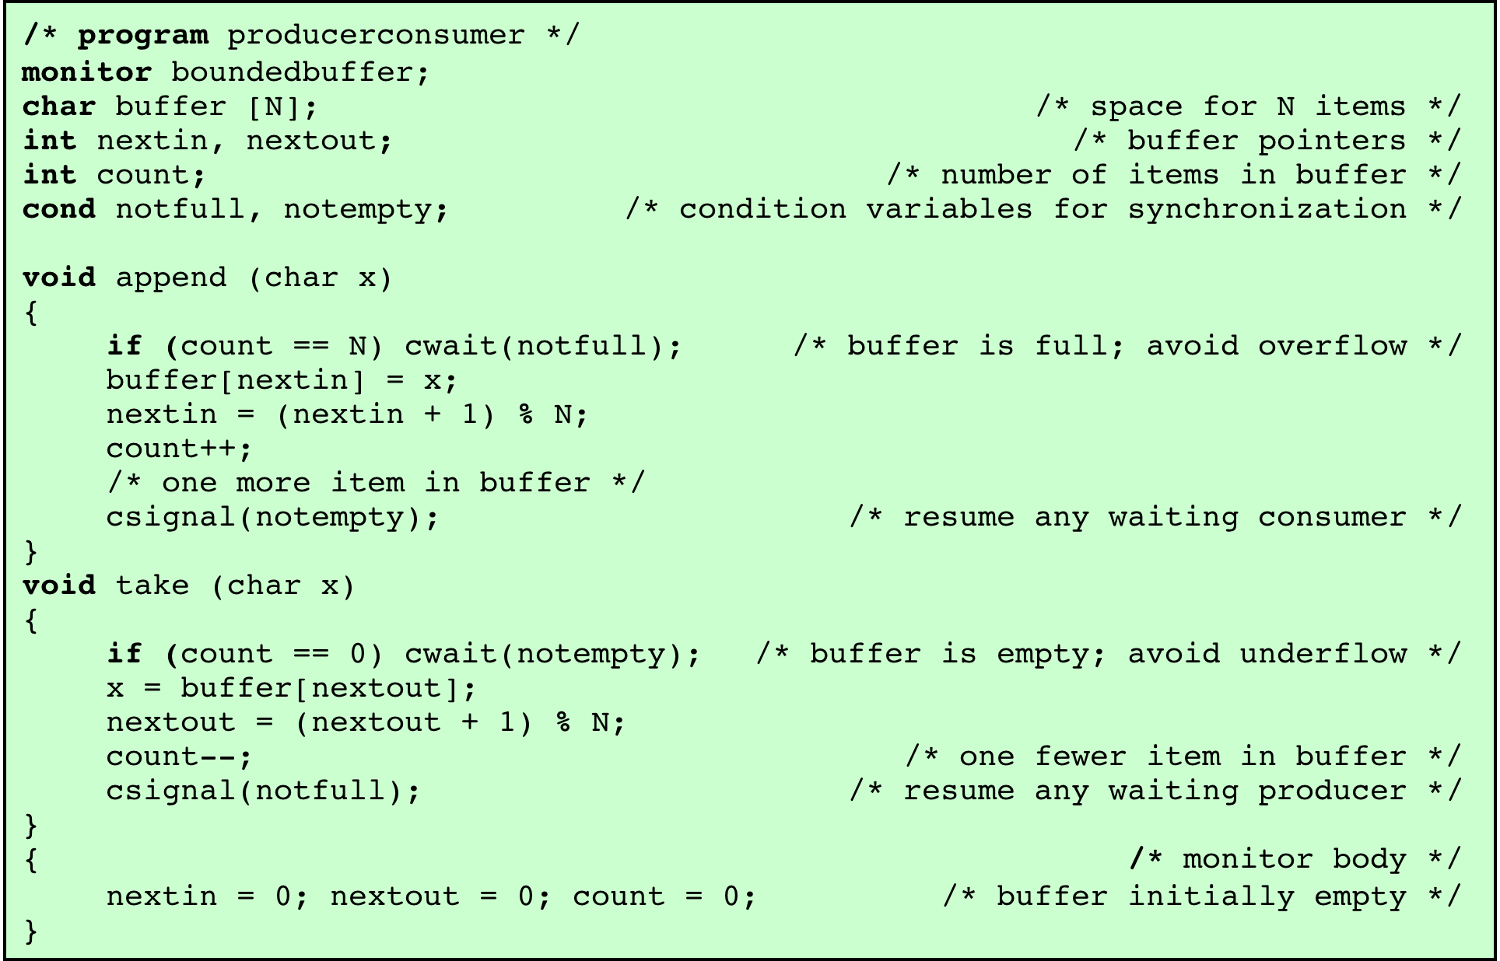
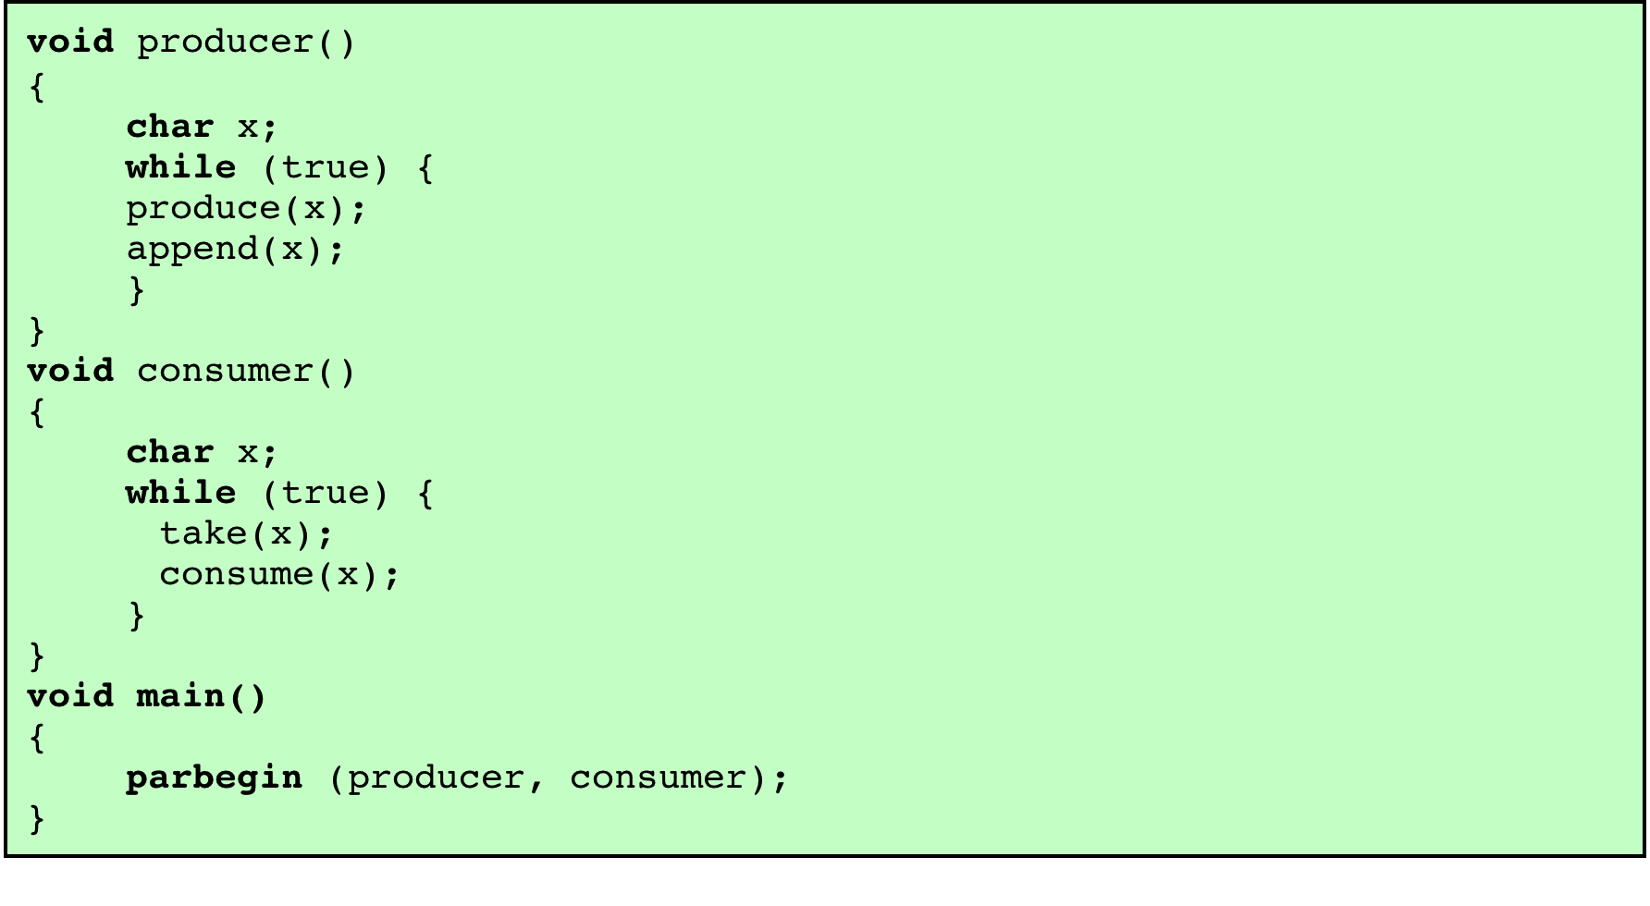
Solution to the Bounded-Buffer Producer/Consumer Problem Using a Monitor
Notes:
As an example of the use of a monitor, let us return to the bounded-buffer producer/consumer problem. Figure 5.16 shows a solution using a monitor. The monitor module, boundedbuffer , controls the buffer used to store and retrieve characters. The monitor includes two condition variables (declared with the construct cond ): notfull is true when there is room to add at least one character to the buffer, and notempty is true when there is at least one character in the buffer.
A producer can add characters to the buffer only by means of the procedure append inside the monitor; the producer does not have direct access to buffer . The procedure first checks the condition notfull to determine if there is space available in the buffer. If not, the process executing the monitor is blocked on that condition. Some other process (producer or consumer) may now enter the monitor. Later, when the buffer is no longer full, the blocked process may be removed from the queue, reactivated, and resume processing. After placing a character in the buffer, the process signals the notempty condition. A similar description can be made of the consumer function.
This example points out the division of responsibility with monitors compared to semaphores. In the case of monitors, the monitor construct itself enforces mutual exclusion: It is not possible for both a producer and a consumer simultaneously to access the buffer. However, the programmer must place the appropriate cwait and csignal primitives inside the monitor to prevent processes from depositing items in a full buffer or removing them from an empty one. In the case of semaphores, both mutual exclusion and synchronization are the responsibility of the programmer.
Note that in Figure 5.16 , a process exits the monitor immediately after executing the csignal function. If the csignal does not occur at the end of the procedure, then, in Hoare’s proposal, the process issuing the signal is blocked to make the monitor available and placed in a queue until the monitor is free. One possibility at this point would be to place the blocked process in the entrance queue, so that it would have to compete for access with other processes that had not yet entered the monitor. However, because a process blocked on a csignal function has already partially performed its task in the monitor, it makes sense to give this process precedence over newly entering processes by setting up a separate urgent queue ( Figure 5.15 ). One language that uses monitors, Concurrent Pascal, requires that csignal only appear as the last operation executed by a monitor procedure.
If there are no processes waiting on condition x , then the execution of csignal( x ) has no effect.
As with semaphores, it is possible to make mistakes in the synchronization function
of monitors. For example, if either of the csignal functions in the boundedbuffer
monitor are omitted, then processes entering the corresponding condition
queue are permanently hung up. The advantage that monitors have over semaphores
is that all of the synchronization functions are confined to the monitor. Therefore, it
is easier to verify that the synchronization has been done correctly and to detect bugs.
Furthermore, once a monitor is correctly programmed, access to the protected resource
is correct for access from all processes. In contrast, with semaphores, resource access is
correct only if all of the processes that access the resource are programmed correctly.

Slide 64
Barriers
Sometimes we have algorithms that are a mix of parallel and sequential steps
When going from the parallel to the sequential phase, we may need to stop, collate results, etc.
We want a way to force a group of processes / threads to wait until all have finished

Slide 65
Barrier Example
Suppose we have an algorithm that relies on repeatedly updating a matrix by multiplying it: Mn = Mn-1 * C
The matrix multiplication can be parallelized by splitting it into submatrices
But we can't update the final matrix until all subthreads have finished – so we need a barrier after each iteration

Slide 66





Parallel Matrix Multiplication

Slide 67
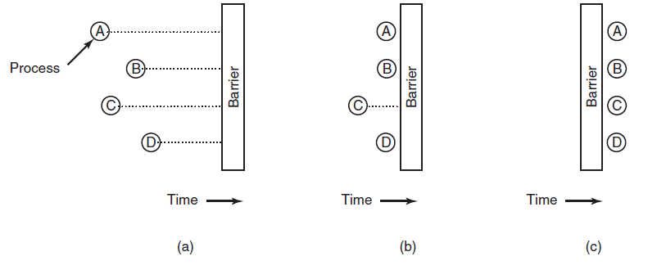
Barriers
Use of a barrier. (a) Processes approaching a barrier. (b) All processes but one blocked at the barrier. (c) When the last process arrives at the barrier, all of them are let through.

Slide 68
Read-Copy-Update
Locking and mutual exclusion have inherent overhead
Time spent waiting for a lock is time you can't do other work
Reduces the speedup from multithreading / multiprocessing
The best kind of locking is when you can avoid locking!

Slide 69
Read-Copy-Update
If we're okay with some readers seeing an old version of a data structure for a while, we can sometimes avoid locking
The trick is to update the structure but not free deleted items immediately – instead, wait until all readers are done

Slide 70
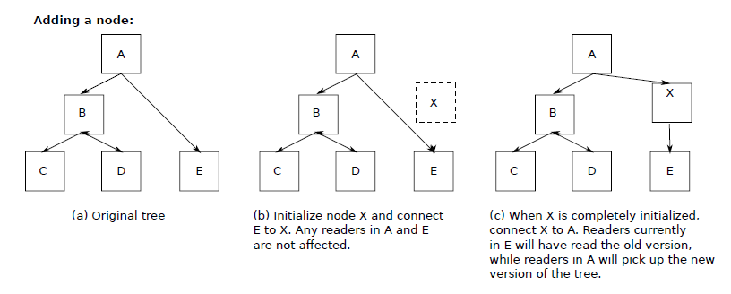
Avoiding Locks: Read-Copy-Update (1)
Read-Copy-Update: inserting a node in the tree and then removing a branch—all without locks

Slide 71
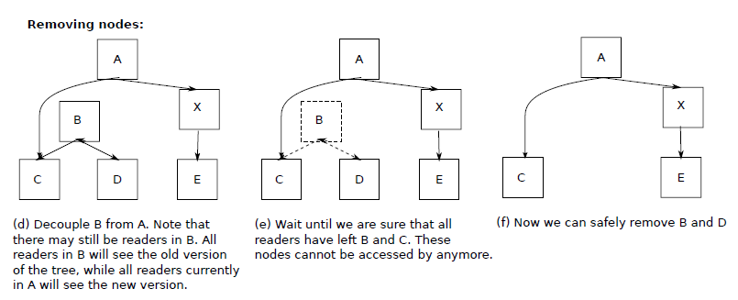
Avoiding Locks: Read-Copy-Update (2)
Read-Copy-Update: inserting a node in the tree and then removing a branch—all without locks

Slide 72
Read-Copy-Update API
When can we safely delete old nodes? When there are no more readers
We add an API called a read-side critical section that any readers of the structure must call when they read something from it
Note that this doesn't involve mutual exclusion – it's just a way to track who's reading
Now we know we can free a node when all the readers have left their critical sections

Slide 73
pthreads

Slide 74
Synchronization in POSIX
The standard way to do multithreading in C on POSIX (UNIX-like) systems is the pthread interface
Allows creation & management of threads, and offers many standard synchronization primitives

Slide 75
pthread Basics
Each thread is identified by a pthread_t data type
Threads can be created using int pthread_create( pthread_t *thread, const pthread_attr_t *attr, void *(*start_routine) (void *), void *arg );
You can exit a thread by either returning from its start routine or calling void pthread_exit(void *retval);

Slide 76
#include <pthread.h>
#include <stdio.h>
#include <stdlib.h>
#define NUM_THREADS 5
void *PrintHello(void *threadid)
{
long tid;
tid = (long)threadid;
printf("Hello World! It's me, thread #%ld!\n", tid);
pthread_exit(NULL);
}
int main(int argc, char *argv[])
{
pthread_t threads[NUM_THREADS];
int rc;
long t;
for(t=0;t<NUM_THREADS;t++){
printf("In main: creating thread %ld\n", t);
rc = pthread_create(&threads[t], NULL, PrintHello, (void *)t);
if (rc){
printf("ERROR; return code from pthread_create() is %d\n", rc);
exit(-1);
}
}
/* Last thing that main() should do */
pthread_exit(NULL);
}

Slide 77
Coordinating Threads
The main thread can join a thread to wait until it's finished int pthread_join(pthread_t thread, void **retval);
By doing this in a loop for all threads we can implement a barrier

Slide 78
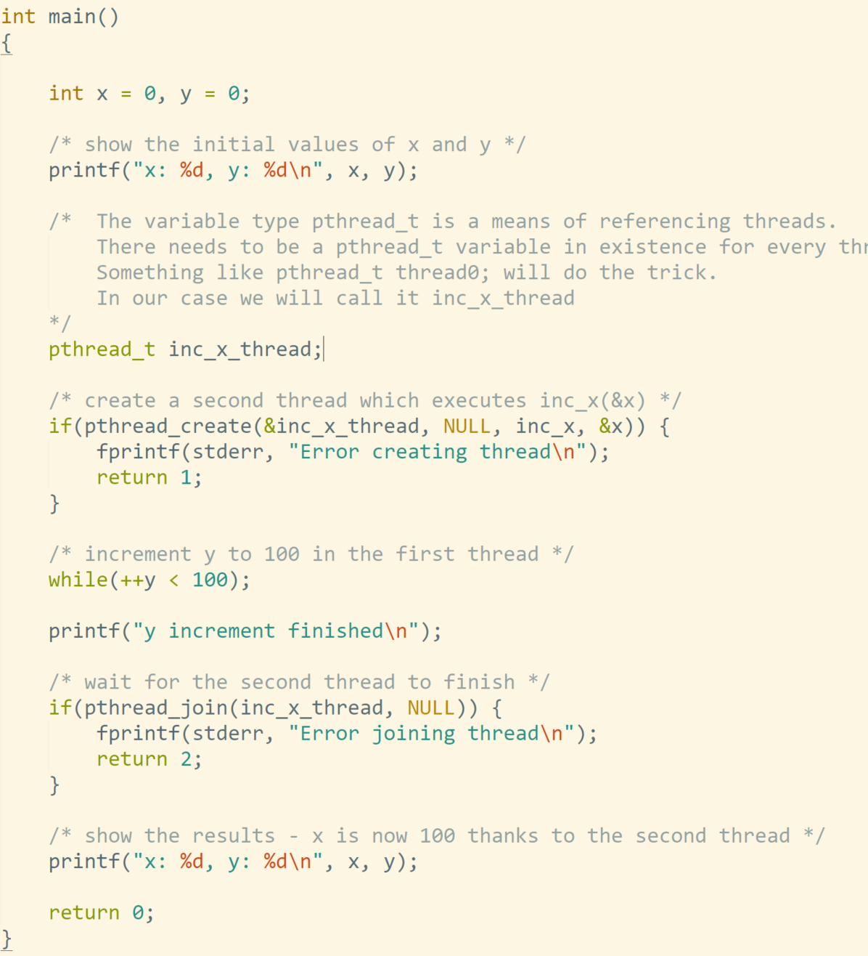
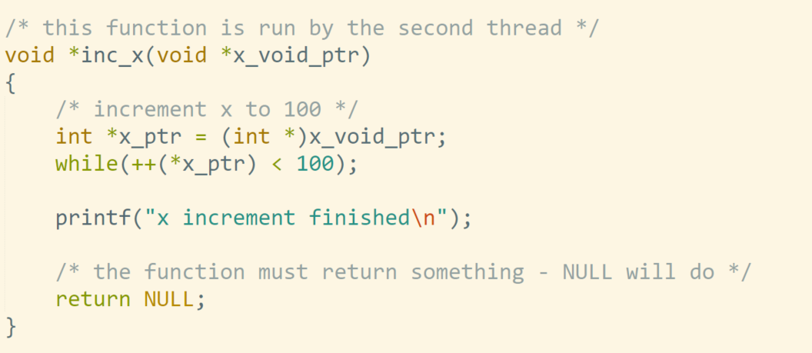

Slide 79
Mutexes
You can create a mutex with int pthread_mutex_init(pthread_mutex_t *mutex, const pthread_mutexattr_t *attr);
Statically allocated mutexes can just do: pthread_mutex_t mutex = PTHREAD_MUTEX_INITIALIZER;
Then, you have some standard operations on it: int pthread_mutex_lock(pthread_mutex_t *mutex); int pthread_mutex_trylock(pthread_mutex_t *mutex); int pthread_mutex_unlock(pthread_mutex_t *mutex);

Slide 80
backup

Slide 81

Lock Requirements
Must guarantee that only one process / thread is in the critical section at a time
This is obvious
Must guarantee progress
Processes or threads don’t have to wait for an available lock
Must guarantee bounded waiting
No process or thread needs to wait forever to enter the critical section
Figuring out the bound can be interesting

Slide 82

Implementing Critical Sections
Goal:
If milk needed, somebody buys
Only one person buys milk
Idea: Wait while note is up
"Busy wait" loop
Does this work?
Is milk bought?
Can both buy?
P0:
while (Note) {
}
leave Note
Note ←← Milk ←← Note ←←
1; // Milk + 0; //
1; // CritSect
remove Note
P1:
while (Note) {
}
leave Note
Note ←← Milk ←← Note ←←
1; // Milk + 0; //
1; // CritSect
remove Note
FAILS: Can both buy milk (How?)
Milk V.1

Slide 83
Implementing Critical Sections
Goal:
If milk needed, somebody buys
Only one person buys milk
Idea: Add per-process flag
Set flag while in critical section
Explicit check on other process
Does this work?
Is milk bought?
Can both buy?
flag[2] = {0,0};
P0:
while (flag[1]) { } flag[0] ←← 1;
Milk ←← Milk + 1; flag[0] ←← 0;
// Crit
sect
P1:
while (flag[0]) { }
flag[1] Milk ←← flag[1]
= 1;
Milk + 1;
= 0;
// Crit
sect
FAILS: Can both buy milk (How?)
Milk V.2

Slide 84








Implementing Critical Sections
Goal:
If milk needed, somebody buys
Only one person buys milk
Reverse order in which you set and test flag
Set flag before testing this time
Does this work?
Is milk bought?
Can both buy?
flag[2] = {0,0};
P0:
flag[0] ←← 1;
while (flag[1]) { } Milk ←← Milk + 1; // flag[0] ←← 0;;
Crit
sect
P1:
flag[1] ←← 1;
while (flag[0]) { } Milk ←← Milk + 1; // flag[1] ←← 0;
Crit
sect
FAILS: Violates progress and bounded wait
Milk V.3

Slide 85
Implementing Critical Sections
Goal:
If milk needed, somebody buys
Only one person buys milk
Idea: Alternating turns
Let one in at a time
Wait your turn
Does this work?
Is milk bought?
Can both buy?
turn ←← 0;
P0:
while (turn == Milk ←← Milk + turn ←← 1;
1) { }
1; // Crit
sect
P1:
while (turn == Milk ←← Milk + turn ←← 0;
0) { }
1; // Crit
sect
FAILS: Violates progress and bounded waiting
Milk V.4

Slide 86
Implementing Critical Sections
Goal:
If milk needed, somebody buys
Only one person buys milk
Idea: Combine approaches
Use flag[ ] to denote interest
Use turn to break ties
Does this work?
Is milk bought?
Can both buy?
flag[2] ←←
{0,0};
turn ←← 0;
P0:
flag[0] ←←
1; turn ←← 1;
while (flag[1] Milk ←← Milk +
&& turn == 1; // Crit
1) { }
sect
flag[0] ←← 0;
P1:
flag[1] ←←
1; turn ←← 0;
&& turn == 1; // Crit
while (flag[0] Milk ←← Milk + flag[1] ←← 0;
0) { }
sect
SUCCEEDS:
Meets all three criteria for locks
Milk V.5

Slide 87

Peterson’s Algorithm
Algorithm on previous slide was published by Peterson in 1981
Should work on any uniprocessor
» Relies only on atomicity of memory operations
Can be extended to more than 2 threads
Peterson’s algorithm does not work on any modern multicore machine
It depends on certain guarantees provided by the memory subsystem, such as not reordering stores
Fixing the algorithm is not totally trivial
These fixes are not portable to other architectures

